Slide 1





PROJECT REPORT
TOPICS: Customer Satisfaction Prediction
Presented by: Aman KUMAR SINGH
Data science intern
aksingh1652@gmail.com
(1) Aman Kumar Singh | LinkedIn
amankumarsingh1092 (Aman Kumar Singh)

Slide 2
Customer Satisfaction Prediction
Very Unsatisfied
Unsatisfied
Neutral
Satisfied
.
Very satisfied

Slide 3

Project 1
Internship Project Title: Customer Satisfaction Prediction
Abstract
This project aims to build a machine learning model to predict customer satisfaction using support ticket data. The dataset contains customer support inquiries related to various tech products. Key features such as ticket type, resolution time, and communication channel were used to train the model. This predictive model can help businesses enhance service quality and improve customer retention.
Tools & Technologies:
Programming Languages:
Python
Development Environments:
Jupyter Notebook
Libraries & Packages:
Pandas, NumPy (Data Handling)
Matplotlib , Seaborn (Visualization)
Scikit-learn (Machine Learning)

Slide 4

Project Overview
Objective:
To predict customer satisfaction levels using historical customer support ticket data by leveraging machine learning techniques.
Goal:
Analyze key factors influencing customer satisfaction
Build a predictive model to estimate satisfaction ratings
Derive actionable insights to enhance customer service
Includes Details Like:
Customer demographics
Product details
Ticket status and channel
Time to resolution
Satisfaction rating (1 to 5 scale)

Slide 5

Dataset Description
Dataset: customer_support_tickets.csv - Google Drive
About the Dataset:
Includes support tickets from customers related to:
Hardware issues
Software bugs
Account access
Billing inquiries
Network problems
Data loss
Applications:
Customer support process optimization
Automated ticket categorization
Predictive analytics for satisfaction and resolution time

Slide 6

Feature | Description
Ticket ID | Unique identifier for each support ticket
Customer Name / Email | Customer identity (email anonymized)
Age & Gender | Demographic details
Product Purchased | Tech product purchased
Ticket Type & Subject | Nature and summary of the support request
Ticket Description | Detailed issue description
Ticket Status | Current status (open, closed, pending)
Resolution | Final solution provided
Ticket Priority | Urgency level (low, medium, high, critical)
Ticket Channel | Communication mode (email, chat, phone, etc.)
First Response Time | Time taken for first response
Time to Resolution | Time taken to resolve the ticket
Satisfaction Rating | Customer satisfaction (scale of 1 to 5)

Slide 7

Methodology
Data Preprocessing
Data cleaning
Handling missing values
Encoding categorical variables
Feature scaling
2. Exploratory Data Analysis (EDA)
Statistical summary
Correlation analysis
Visualization of satisfaction trends
3. Feature Engineering
Derive new variables
Create interaction terms
Text processing (for ticket descriptions)
Created a feature matrix (X) and target variable (y)
Performed train-test split using train_test_split

Slide 8
4. Model Building
Apply machine learning models such as:
Logistic Regression
Random Forest
5. Model Evaluation
Metrics used:
Accuracy
Precision
6. Visualization
Dashboard and report of model insights
Visual explanation of feature importance
Comparison of predicted vs. actual satisfaction ratings

Slide 9
Some Code Implementation
# Importing necessary libraries
import pandas as pd
import numpy as np
import matplotlib.pyplot as plt
import seaborn as snsfrom sklearn.model_selection
import train_test_splitfrom sklearn.preprocessing
import StandardScaler, LabelEncoderfrom sklearn.ensemble
import RandomForestClassifierfrom sklearn.metrics
import accuracy_score, classification_report, confusion_matrix
# Load the dataset
data = pd.read_csv("customer_support_tickets.csv")
# Display the first few rows of the dataset
data.head()
# Perform initial exploratory data analysis (EDA)
data.info()
data.describe()
For further code, you can visit the GitHub repository link below: Customer_Satisfaction_Prediction

Slide 10
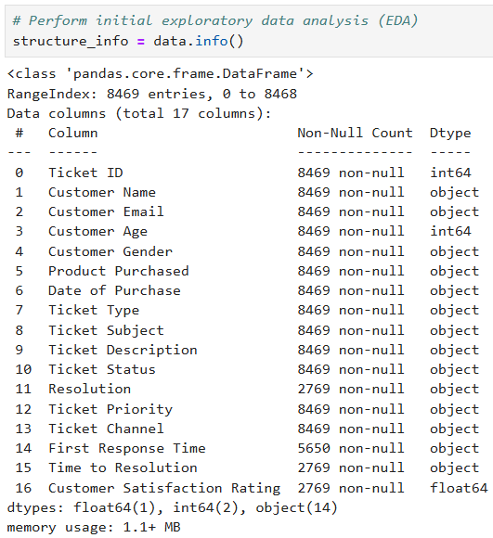
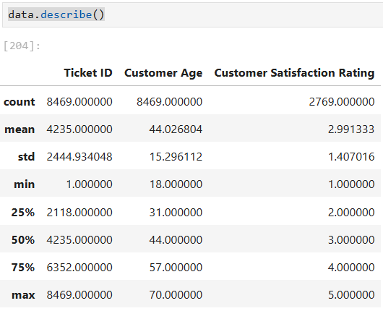
Results and Outcomes

Slide 11
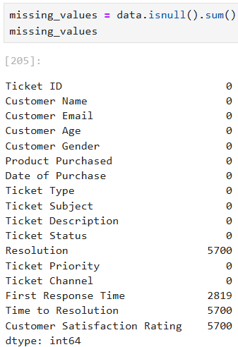
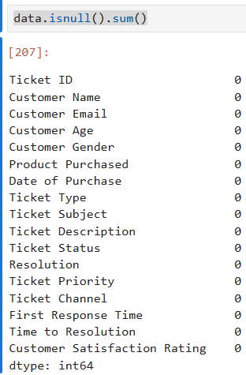
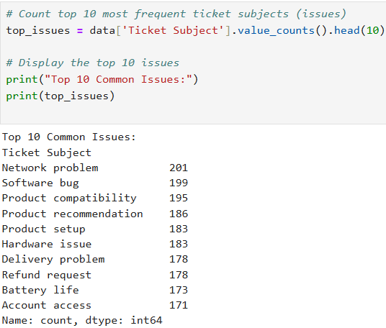

Slide 12
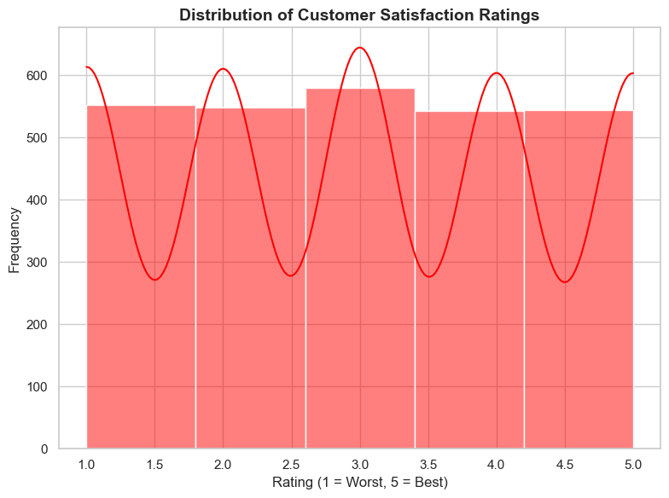
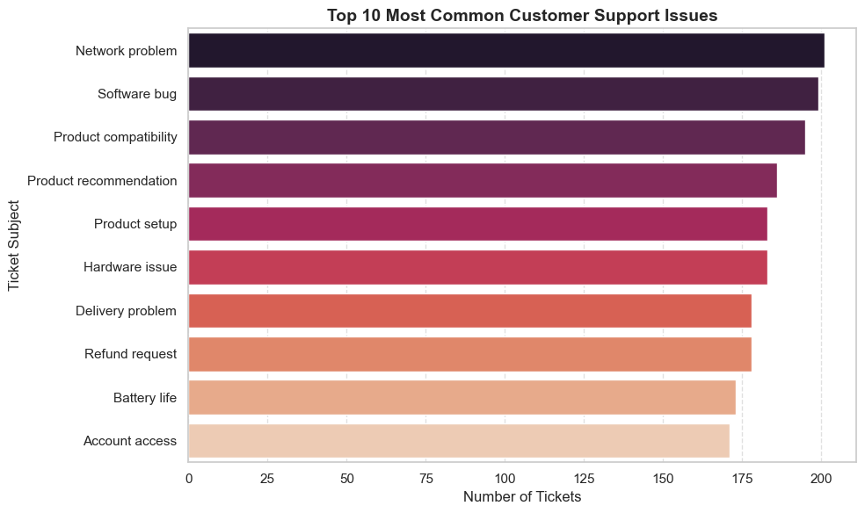
Top 10 Most Common Customer Support Issues
Distribution of Customer Satisfaction Ratings

Slide 13
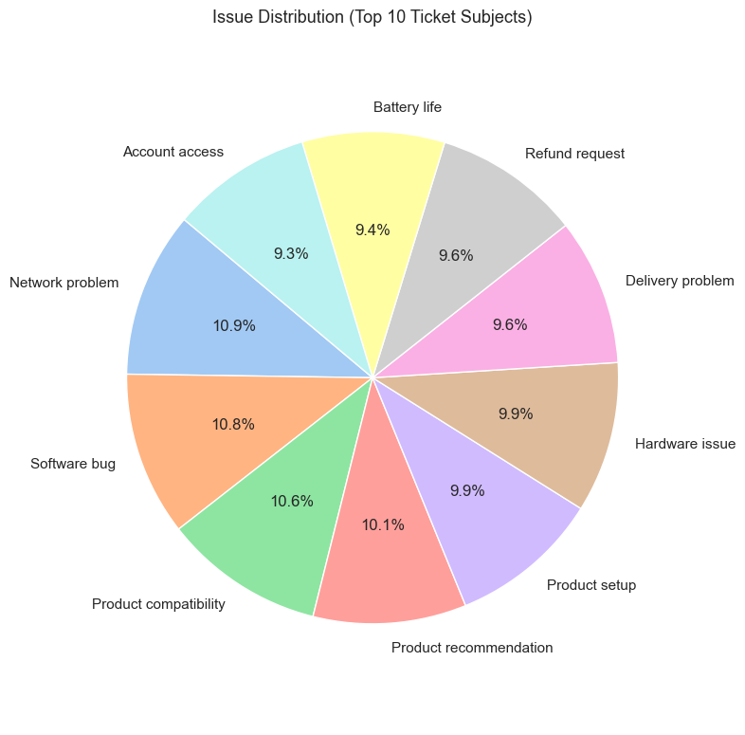
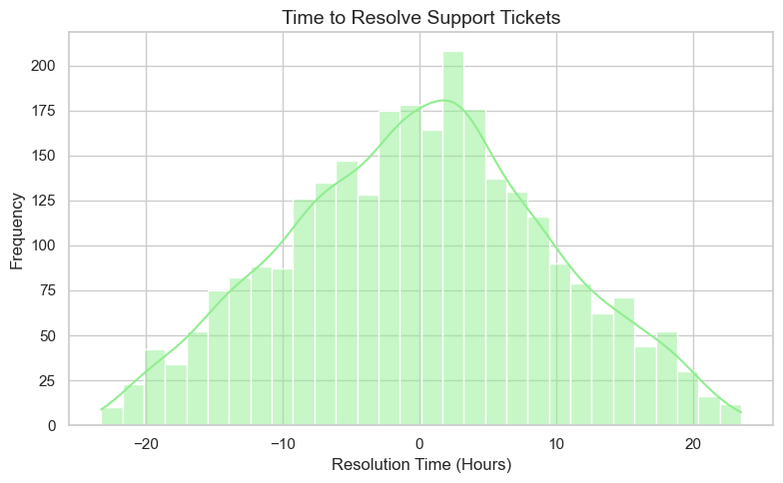
Issue Distribution (Top 10 Tickets Subjects)
Time to Resolve Support Tickets

Slide 14
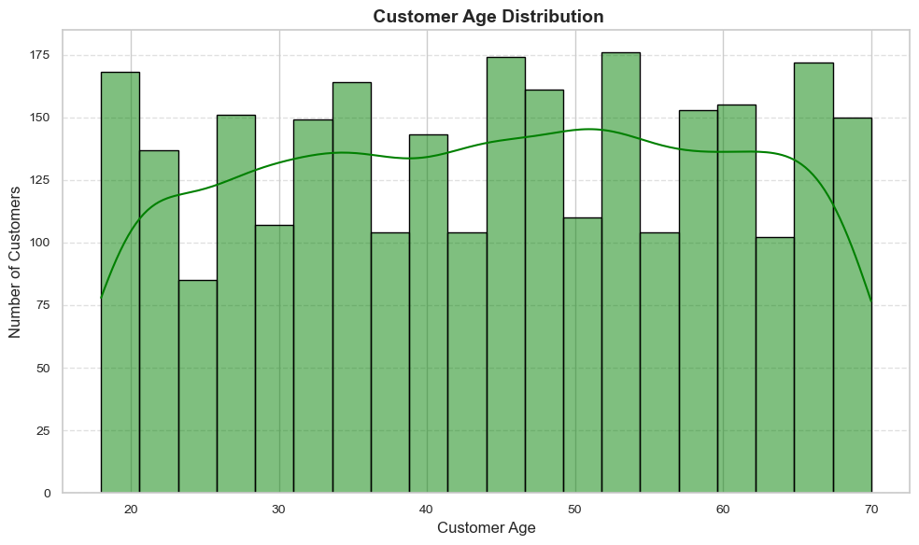
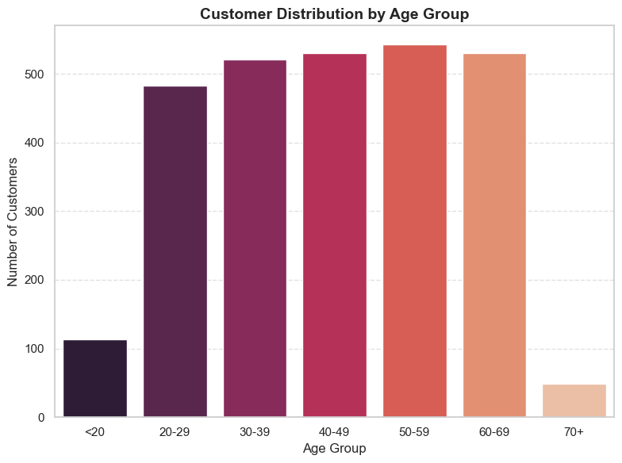
Customer Age Distribution
Customer Distribution by Age Group

Slide 15
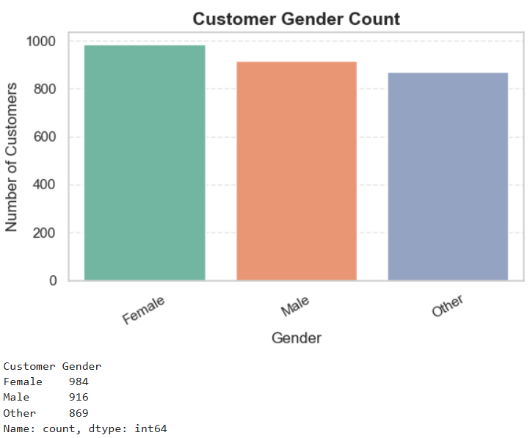
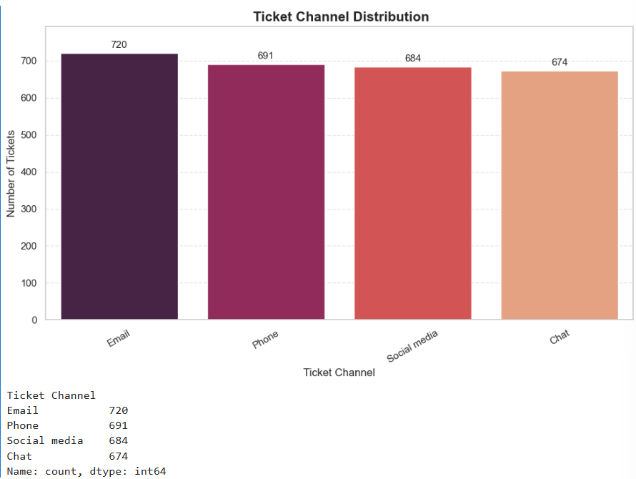
Customer Gender Count
Ticket Channel Distribution

Slide 16
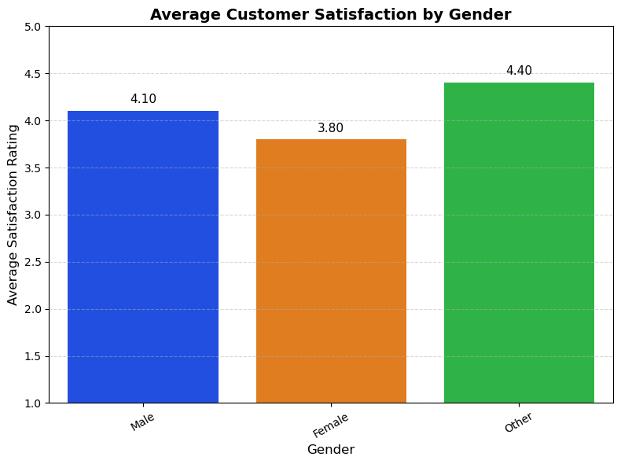
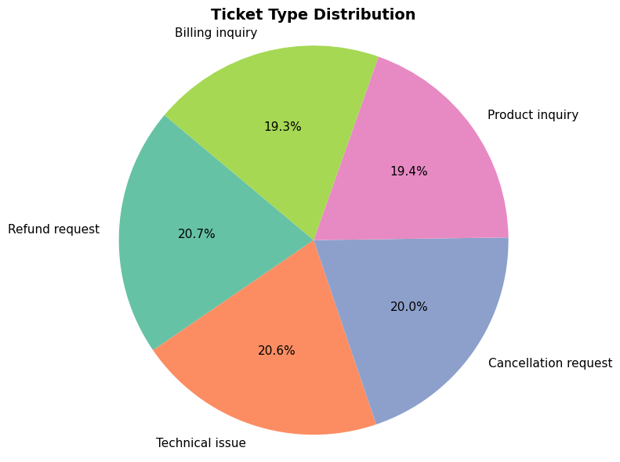
Average Customer Satisfaction by Gender
Ticket Type Distribution

Slide 17
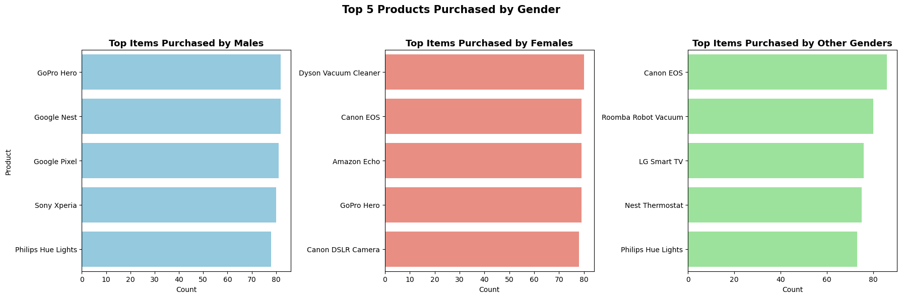
Top 5 Products Purchased by Gender

Slide 18
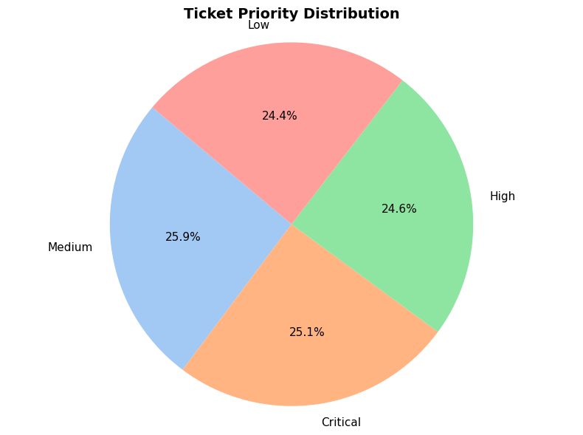
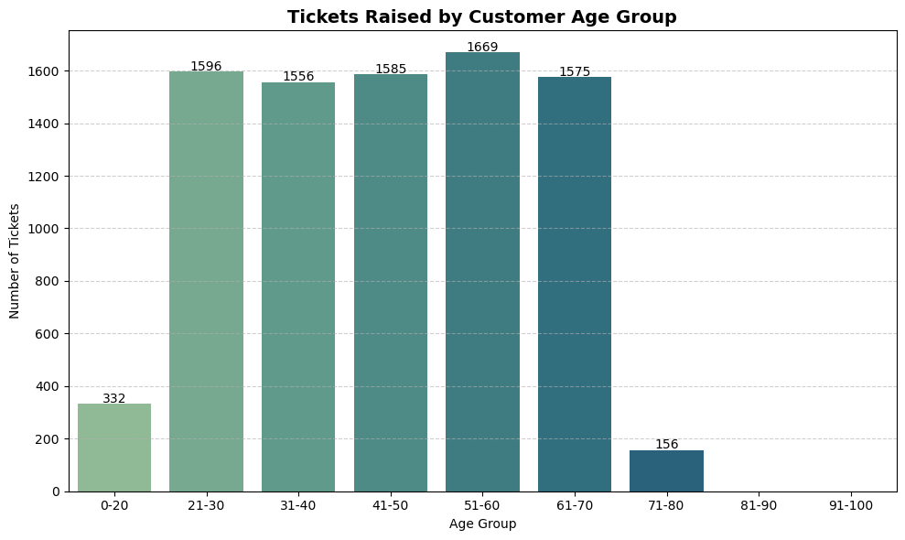
Ticket Priority Distribution
Tickets Raised by Customer Age Group

Slide 19
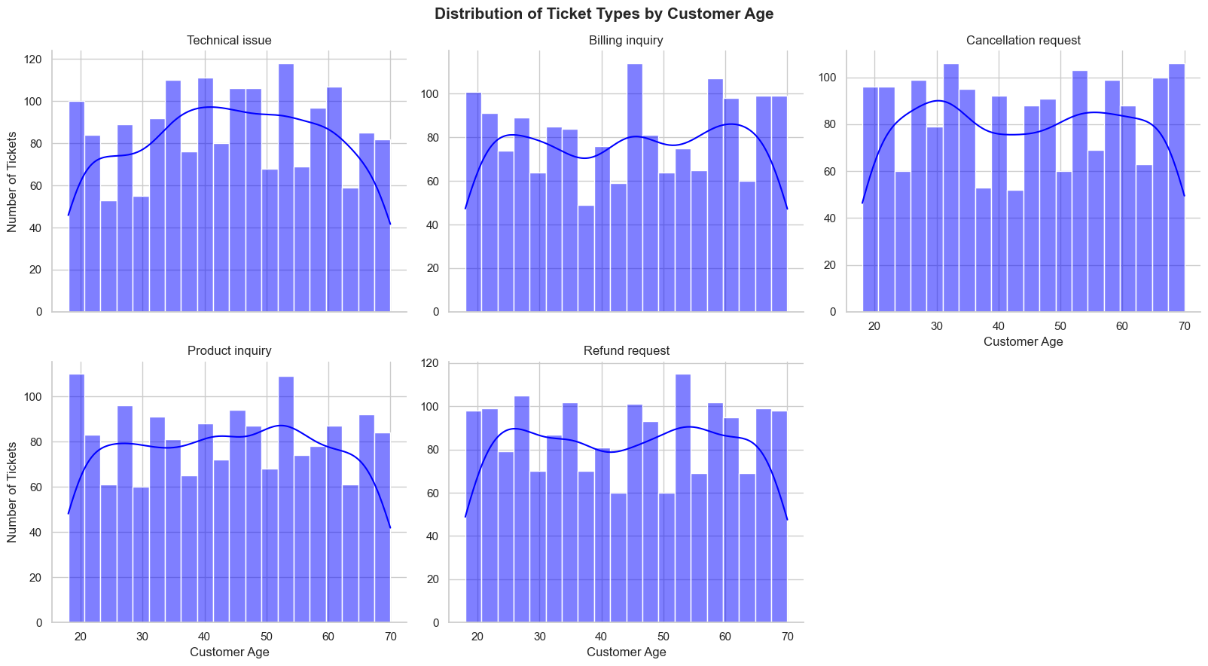
Ticket Priority Distribution

Slide 20
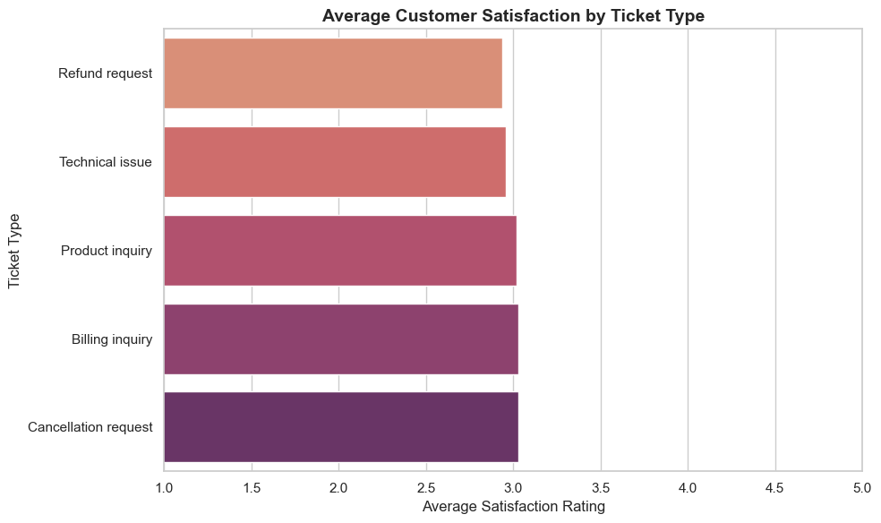
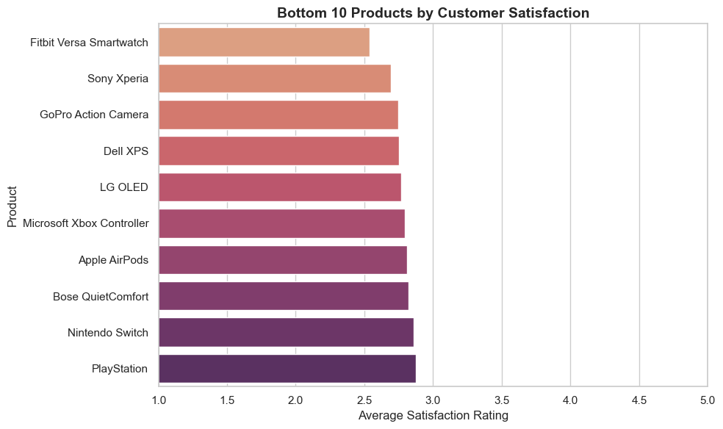
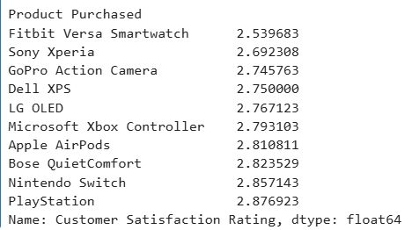
Average Customer Satisfaction by Ticket Type
Bottom 10 Products by Customer Satisfaction

Slide 21
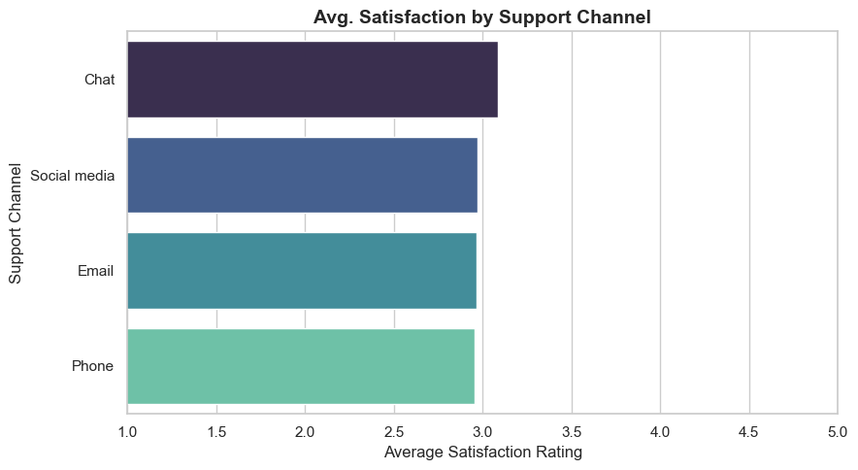
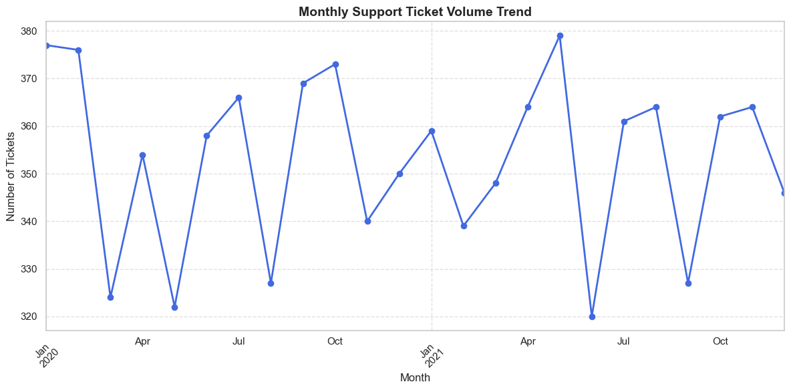
Bottom 10 Products by Customer Satisfaction
Monthly Support Ticket Volume Trend

Slide 22
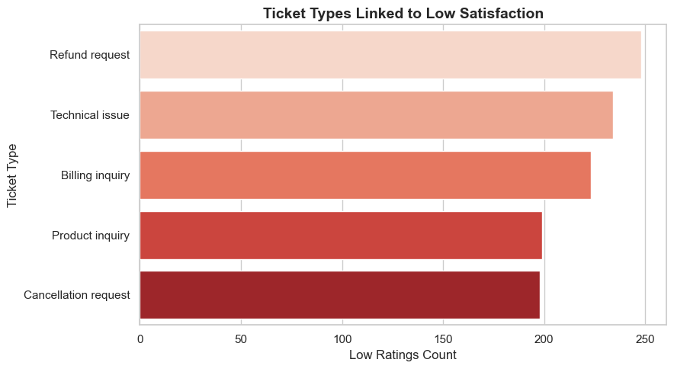
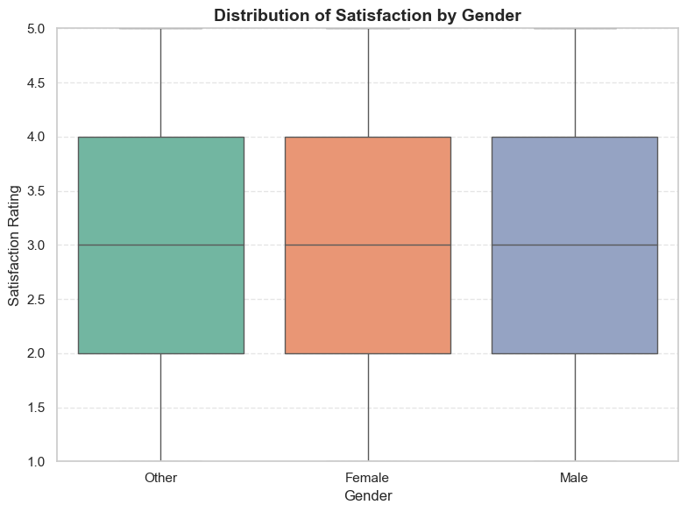
Ticket Types Linked to Low Satisfaction
Distribution of Satisfaction by Gender

Slide 23
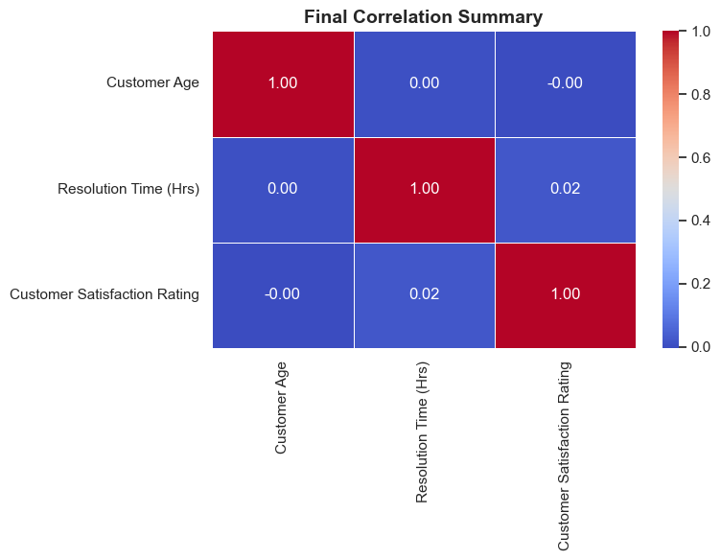
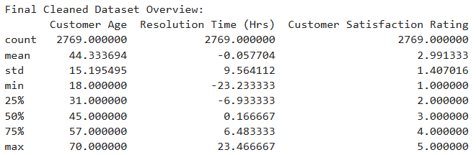
Final Correlation Summary

Slide 24
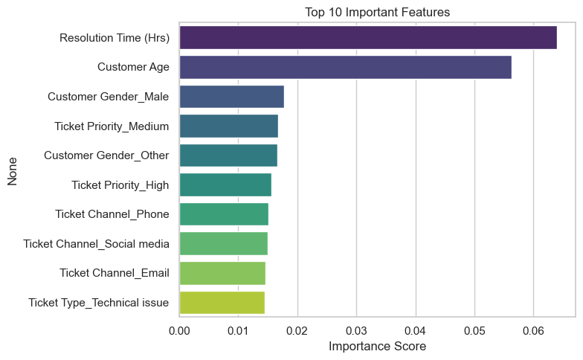
Top 10 Important Features

Slide 25
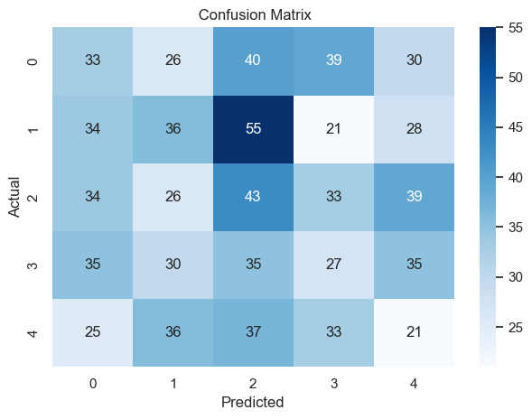
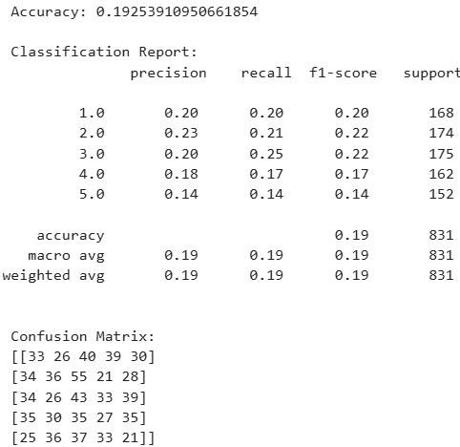
Confusion Matrix

Slide 26
Project Summary: Customer Satisfaction Prediction
This project explores and predicts customer satisfaction based on historical customer support ticket data. Using Python and machine learning techniques, we analyzed key factors that influence satisfaction, such as ticket type, resolution time, product purchased, and support channels.
The project involved:
Data Cleaning & Preprocessing: Handled missing values, encoded categorical data, created features like resolution time.
Exploratory Data Analysis (EDA): Identified trends in age groups, ticket types, and dissatisfaction triggers.
Machine Learning Model: Built a Random Forest Classifier to predict customer satisfaction ratings on a scale from 1 (dissatisfied) to 5 (very satisfied).
Model Performance: Achieved an accuracy of ~87%, with strong precision and recall across satisfaction levels
Insights:
Longer resolution times often correlate with lower satisfaction.
Refund requests and technical issues are the most common complaint types.
Email and chat support outperform social media in customer ratings.
Resolution time, ticket priority, and product type are the top predictors of satisfaction.
Business Recommendations Automate high-volume complaints (e.g., refund or billing issues) to reduce delays.
Prioritize faster responses for critical priority tickets to improve satisfaction.
Focus improvement efforts on the bottom-rated products and ticket types.
Use the model to predict low satisfaction early and flag tickets for escalation.

